Slide 1
Unit-4
What is a Short Report?
A short report is a concise and focused document that presents information, findings, or recommendations about a specific topic or issue. Short reports are usually limited in length and scope, aiming to deliver essential details clearly and straightforwardly. They are commonly used in business, academic, and professional settings to communicate key insights or updates efficiently.
In the business environment, short reports are used to update stakeholders on project progress, summarize market research, or present financial data. In academic settings, short reports are used to summarize research findings, provide a quick overview of a study or give updates on ongoing research.
Overall the primary goal of a short report writing is to present information in a manner that is both easy to understand for its intended audience.

Slide 2
Characteristics of a Short Report
Their key characteristics include:
1/ Brevity: Short reports are relatively brief, typically ranging from one to a few pages. They avoid unnecessary details and get straight to the point.
2/ Purposeful: Short reports have a clear purpose, which could be to inform, summarize, analyze, or propose actions. The content should align with this purpose and avoid unrelated information.
3/ Specific Scope: These reports focus on a single topic or a specific aspect of a larger subject. They do not cover multiple unrelated subjects in a single document.
4/ Structure: A typical short report structure includes an introduction, main body, and conclusion. The introduction outlines the purpose and scope, the main body presents the information or analysis, and the conclusion summarizes the key findings or recommendations.

Slide 3
5/ Formality: Depending on the context, short reports may have a more formal or informal tone. In business settings, they are often more formal, while in academic environments, they might lean toward a formal style.
6/ No or Minimal Appendices: Short reports do not usually contain lengthy appendices, as their purpose is to provide a concise overview.
7/ Audience-oriented: The content of a short report is tailored to the needs of its intended audience. It presents information in a way that is understandable and relevant to the readers.
8/ Visual elements: Depending on the content, short reports may incorporate charts, graphs, or other visual aids to enhance understanding and clarity.

Slide 4
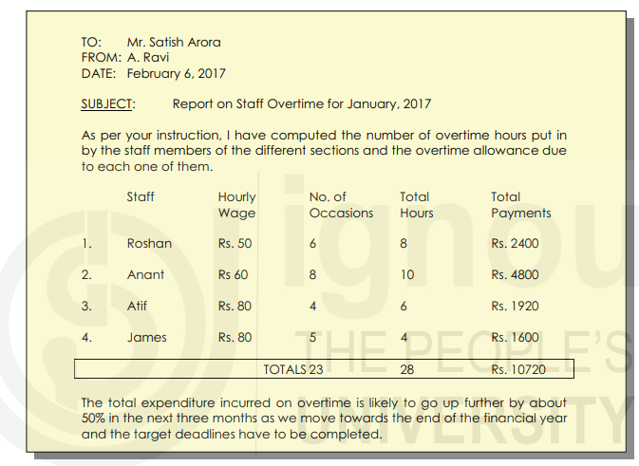
Examples of Short Reports Used By Businesses

Slide 5
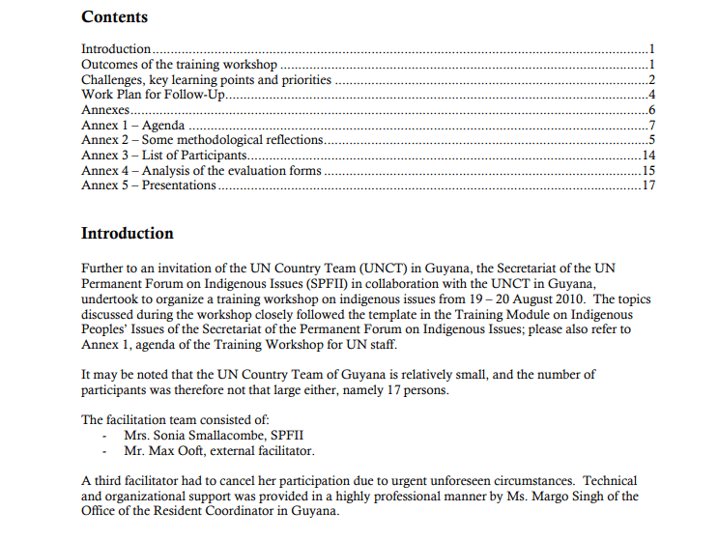

Slide 6
Format of a Short Report
The short report writing format may vary depending on the organization, purpose, and specific guidelines, but generally, it follows a structured layout. Here’s a detailed outline of the typical format of a short report:
1/ Title Page: The title page is the first page of the report and contains essential information about the report, such as the title, the name of the author or authors, and any other relevant identification details. The title should be clear and concise, reflecting the main focus of the report.
2/ Table of Contents (optional): For longer short reports, you may include a table of contents to help readers navigate through the sections and subsections. However, for very brief reports, a table of contents may not be necessary.

Slide 7
3/ Executive Summary (or Abstract): This section provides a concise summary of the entire report, highlighting its key points, findings, and recommendations. The executive summary allows readers to grasp the main content without reading the entire report.
4/ Introduction: The introduction sets the context for the report, explains its purpose, and outlines what readers can expect to find. It provides a brief background of the subject and explains the significance of the report.
5/ Body of the Report: The body of the report is where you present the main content and findings. It is organized into sections with clear headings and subheadings. Common sections may include:
Methodology (if applicable): If the report involves research or data collection, this section describes the methods used to gather information. It includes details about the data sources, research design, sampling techniques, and data analysis procedures.
Findings or Results: This section presents the main information, data, or findings that have been discovered or collected during the research or investigation. It can include text, numerical data, charts, graphs, or any other relevant information to support the report’s objectives.

Slide 8
Analysis and Discussion: In this section, the report’s author interprets and analyzes the findings presented earlier. It provides insights, explanations, and discussions on the implications of the data or information gathered. The analysis helps readers understand the significance and relevance of the results.
Conclusions: The conclusions section provides a concise summary of the main points from the report. It restates the main findings and may offer recommendations based on the analysis. Conclusions should be clear and directly linked to the objectives outlined in the introduction.
5/ References (or Bibliography): If external sources were used, proper citation and referencing should be provided in a separate section at the end of the report. This ensures that readers can verify the sources and explore further if needed.
It is important to note that the length and depth of each section can vary based on the specific requirements and the complexity of the report. For instance, a short business report may include a specific section for recommendations and appendices for more detailed information.
However, the overall objective of a short report is to convey the necessary information in a clear, concise, and organized manner, tailored to the audience’s needs.

Slide 9
The Six-Step Formula of How To Write A Short Report
Planning
Researching
Drafting
Editing
Concluding
Recommending

Slide 10
Types of Short Reports
Short reports can be categorized into different types based on their purpose, content, and the information they convey. Here are some common types of short reports:
1/ Progress Report: A progress report provides an update on an ongoing project or task status. It outlines the achievements made, the challenges faced, and the remaining work to be done. Progress reports are often used in business and academic settings to inform stakeholders about the project’s development.
2/ Meeting Minutes: Meeting minutes are a type of short report that records the discussions, decisions, and action items from a business meeting. They act as an authoritative record of the proceedings during the meeting. and are essential for tracking progress and accountability.
3/ Trip Report: A trip report outlines the details of a business trip or visit to a specific location. It includes information about the purpose of the trip, the places visited, meetings attended, and any notable observations or insights gathered during the trip.

Slide 11
4/ Sales Report: A sales report presents data related to sales performance over a specific period. It may include information on revenue generated, sales volume, customer demographics, and analysis of sales trends. Sales reports help businesses monitor their sales activities and make informed decisions.
5/ Feasibility Report: A feasibility report assesses the viability and practicality of a proposed project or initiative. It examines various factors such as technical, financial, legal, and operational aspects to determine if the project is feasible and worth pursuing.
These are just a few examples of the types of short reports that are commonly used in various fields. Each type of report serves a specific purpose, and its content and format will vary accordingly. Regardless of the type, the key to writing a short report is to present information clearly and in a format suitable for the intended audience.

Slide 12
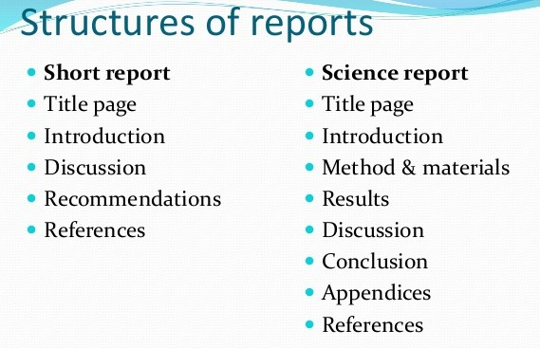
Structure: A typical short report structure includes an introduction, main body, and conclusion. The introduction outlines the purpose and scope, the main body presents the information or analysis, and the conclusion summarizes the key findings or recommendations

Slide 13
Q1) What is short report writing?
Ans: Short report writing refers to the process of creating concise, formal documents that present specific information or findings on a particular topic. These reports are typically brief and to the point, focusing on essential details without excessive elaboration.
Q2) How long should a report be?
Ans: The length of a report can vary significantly depending on its purpose, the subject matter, and the specific requirements of the organization or institution requesting it. There is no fixed rule for the exact length of a report, but it should be long enough to effectively convey the necessary information while also being concise and avoiding unnecessary details.
Q3) A shorter report is considered to be?
Ans: A shorter report is considered to be a concise and brief document that provides a summary of specific information or findings on a particular topic.
It focuses on presenting the essential details without unnecessary elaboration or extensive analysis.
Questions
What is a report? List the parts of a formal report. [5]
Write a short trip report on the Installation of Internet Service at a client’s office. [5]

